Slide 1
Jermyn Borough Council Meeting
10/17/2024

Slide 2

Meeting Agenda
October 17,2024
CALL TO ORDER
PLEDGE OF ALLEGIANCE
ROLL CALL
PREVIOUS MEETING MINUTES
TREASURER REPORT/BILLS PAYABLE
SECRETARY REPORT
CORRESPONDENCE
PUBLIC COMMENT
PROFESSIONAL REPORTS-POLICE, FIRE, SOLICITOR, ZONING, ENGINEER, TAX COLLECTOR, MAYOR
COMMITTEE REPORTS-SAFETY, PLANNING, FINANCE, SHADE TREE, REC, MS4, DPW
EXECUTIVE SESSION
NEW BUSINESS

Slide 3
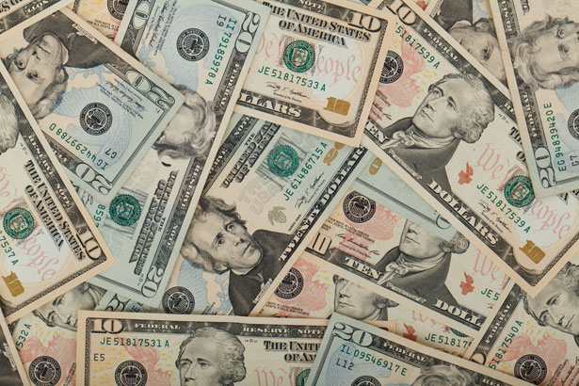
Treasurer’s report
10/17/2024
ASSETS
Checking/Savings
American Rescue Plan Fund 124,770.72
Capital Reserve - DPW 909.64
Capital Reserve - Police 6,064.82
Crime Watch Fund 222.69
General Fund - Community 170,255.27
General Fund - FNB 6,124.68
Holiday Lights Fund 300.59

Slide 4
Treasurer’s report
Investment - General Fund 1,107.42
Investment - Liquid Fuels 24,383.09
Investment - Paving Fund 1,118.95
Investment - Recycling 122.30
Investment - Refuse 174.39
Liquid Fuels - FNB 6,289.45
Petty Cash 196.50
Recreations Fund 28,299.22
Recycling - Community 5,058.76
Refuse Checking - FNB 163,862.88
Total Checking/Savings 539,261.37

Slide 5
Treasurer’s report
200000 · Accounts Payable 78,562.27
Long Term Debt 79,266.38

Slide 6


